Slide 1
EU-Hardwoods WP4 – Glulam made of hardwoods or mixing hardwoods and softwoods Program update Guillaume Legrand – FCBA, June 25-26th, 2015

Slide 2
Expected outcomes
Development of industrial application of hardwoods in timber construction : glue laminated timber (glulam)
Economicaly and technicaly competitive glulam beam build-ups
Simulation (MPA model)
Production and testing (missing data, validation of the model)
Strength model → CEN TC124/WG3 harmonized standard for glulam made of hardwoods
Beam strength ↔ Lamella strength (WP2) and finger joint strength (WP3)

Slide 3
Tasks
4.1. Survey / extraction of data from previous projects
January – June 2015 :
Creation of a template by FCBA to collect data (correlated to the template proposed by FCBA for WP2)
Circulation of the template for comments
Comments → V3 of the template
Feeding of the template by MPA (oak) and FCBA (oak, chestnut)

Slide 4
Tasks
4.1. Survey / extraction of data from previous projects
Feeding of the template by MPA (oak-MUF) and FCBA (oak-MUF, chestnut-MUF)
Origin of data | Specie | Origin specie / GLT production | Config. | Nb of tests | Lamellae thickness (mm) | Lamellae strength grade | Finger joints profile l/p/bt | Beams strength grade
MPA | European Oak | France / Spain | 6 | 60 in bending 30 in compression 15 in tensile | 20 | LS13 (outer) LS10 # D 30 (inner) with add. requirements | 10/3,8/ns
MPA | European Oak | Czech Republic / Germany | 6 | 123 in bending 30 in compression | 20-23 | LS13 | 10/3,8/ns
FCBA | European Oak | France / France | 4 | 37 in bending | 21 | D30 ( + QF2) outer D30 (+ QF4) inner | 20/6,2/1 | GLh30
FCBA | Chestnut | France / France | 2 | 41 in bending 15 in 3 point bending | 22 | C24 | 15/3,8/0,42 | GLh24

Slide 5
Tasks
4.2. Simulation of glued laminated hardwood timber: homogeneous, inhomogeneous, hybrid
July – December 2015
Validation and strengthening of the MPA model using :
Data collected
Data coming from specific glulam production at SIMONIN and tested at FCBA

Slide 6
Tasks
4.3. Production & testing of glued laminated hardwood timber: homogeneous, inhomogeneous, hybrid
October – December 2015 :
First production at SIMONIN :
Proposal :
Specie : Oak (F)
Strength grade : D24 (LS10)
Composition : homogeneous
Sawings : 27 x 150 x 2000 mm (lamellae : 22 mm)
Beams :
250 x 150 x 6000 mm x 20
500 x 150 x 6000 mm x 20

Slide 7
Tasks
4.3. Production & testing of glued laminated hardwood timber: homogeneous, inhomogeneous, hybrid
October – December 2015 :
Testing at FCBA :
Lamellae and finger joints :
Bending tests
Tensile tests
Beams :
Bending tests
Compression tests (longitudinal and transverse)
February – May 2016 :
Second production at SIMONIN
Testing at FCBA

Slide 8
Tasks
4.4. Input of experimental data to fit the model, FE calculations
January – September 2016 :
Economicaly and technicaly competitive glulam beam build-ups
Strength model → CEN TC124/WG3 harmonized standard for glulam made of hardwoods

Slide 9
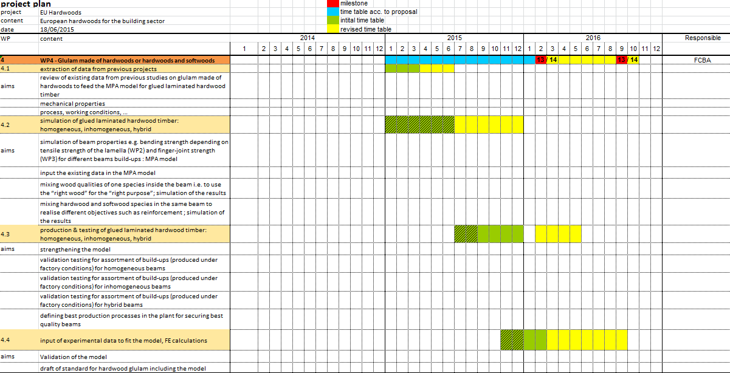

Slide 10
Discussion
Contacts FCBA :
Responsible of the project : Guillaume Legrand (guillaume.legrand@fcba.fr)
WP1 : Morgan Vuillermoz (morgan.vuillermoz@fcba.fr)
WP2 : Jean Denis Lanvin (jean-denis.lanvin@fcba.fr), Didier Reuling (didier.reuling@fcba.fr
WP3 : Guillaume Legrand (guillaume.legrand@fcba.fr)
WP4 : Carole Faye (carole.faye@fcba.fr)

